Slide 1

Trade Platform for Ichimoku Cloud
Team: LullabyOfBirdLand
Rapporteur： Ye zhaozheng

Slide 2
CONTENTS
01
Purpose
02
Project
04
03
Consequent

Slide 3
01
Purpose

Slide 4
What is ichimoku cloud
1
一目均衡表
2
A technical analysis method that builds on candlestick chart
Technical indicator system
3
Five sen/lines
4
雲
5
Wave, trend, emotion

Slide 5
Five lines
1
Tenkan-sen/転換線
(highest high + lowest low)/2 for last 9 period
2
Kijun-sen/基準線
(highest high + lowest low)/2 for last 26 period
3
Senkou-span A
(Tenkan-sen + kijun-sen)/2 plotted 26 periods ahead
Technical indicator system
雲
4
Senkou-span B
(highest high + lowest low)/2 calculated over the past 52 time periods and plotted 26 periods ahead
5
Chikou-span
Today’s closing proice projected back 26 days on the chart

Slide 6
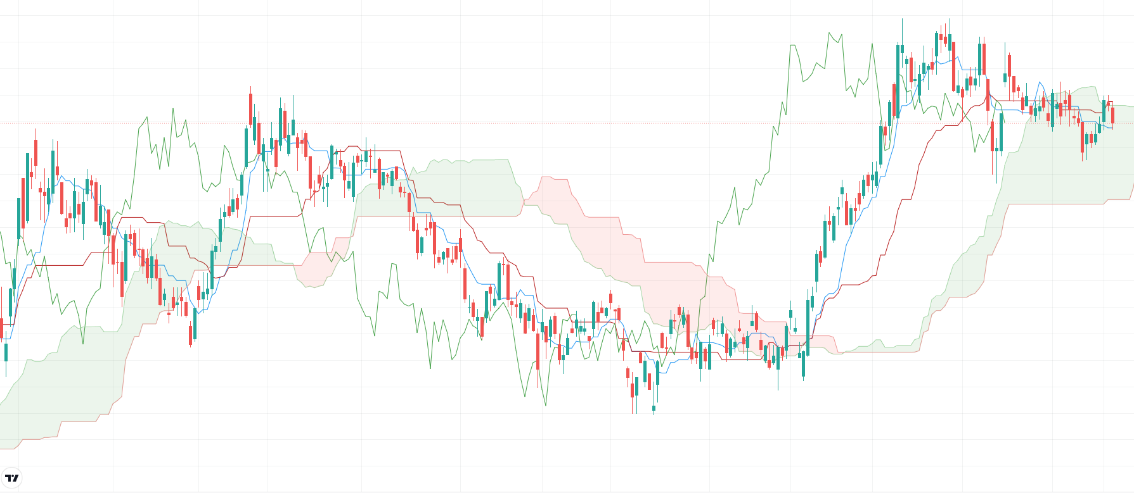
Sample

Slide 7
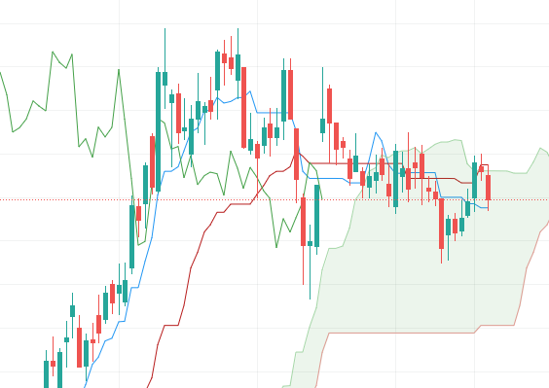
Analysis
1. The cloud with green color shows the uptrend and support level, while red color shows downtrend and resistance level.
2. The kijun and tenkan shows the competition between long position and short position
3. The chikou shows if prediction in the past satisfies the result

Slide 8
Why
1. Most of the tools which could plot this chart are blocked
2. To maximize its risk-adjusted returns, it’s crucial to use it in conjunction with other
technical indicators, such as RSI, MA, or some strategies which are summerized by myself. As to determine the accuray, backtesting is also needed.
3. After establishing the brunch of strategies, use it to dig some interesting products, then collect its basic information like P/E, net profit. All those trivial acitivies could be done by computer.

Slide 9
02
Project

Slide 10
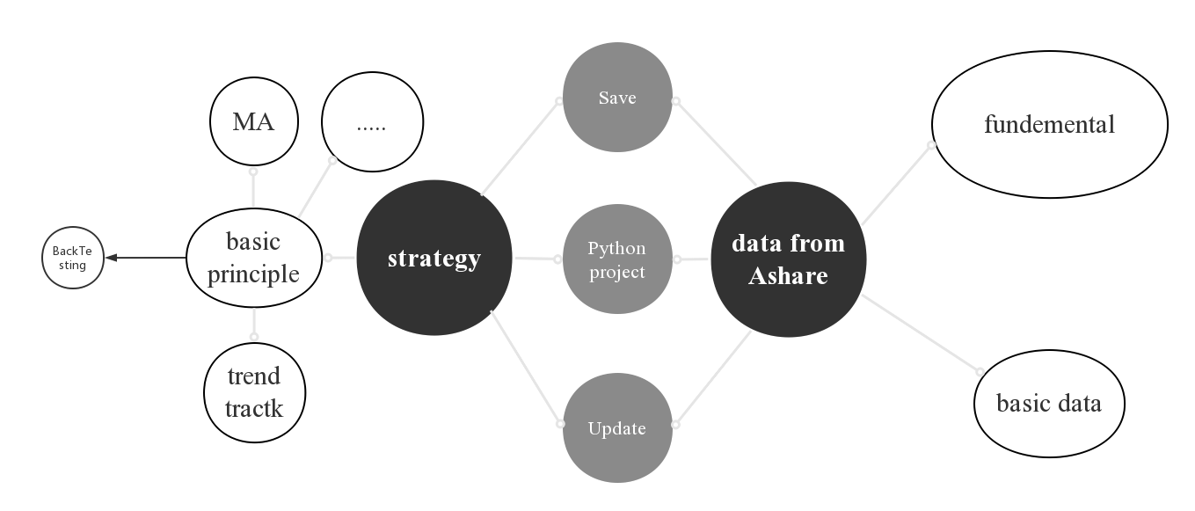
Structure
Basic data in A shares markets within three years
Data
Fundementals for a company

Slide 11

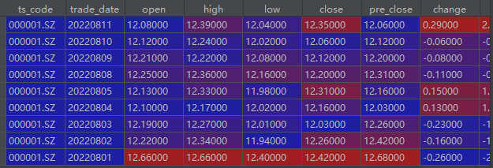
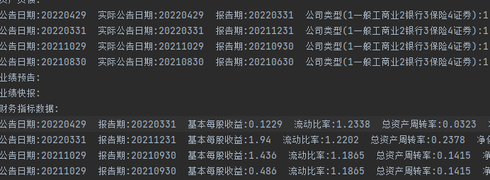
Data
Basic data in A shares markets within three years
For presentation, they are saved locally
Fundementals for a company

Slide 12
BackTesting - To test the subordinate principle
1. Determine the buy signal and sell signal.
2. Rolling data
3.Calculating the profit
4.Analyse abnormal situation
5.Considering of other factors, or position sizing formula
6.Repeat

Slide 13
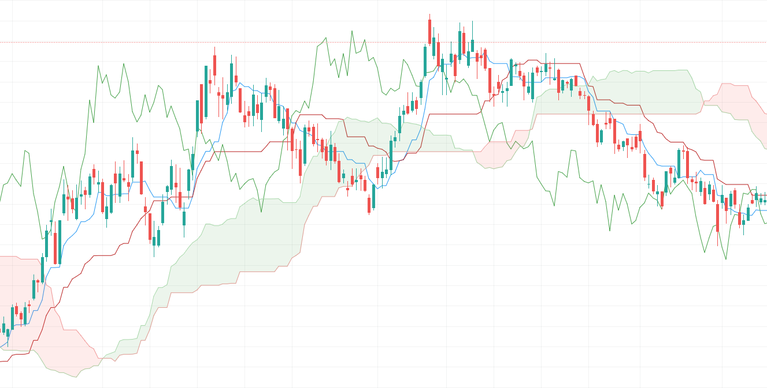
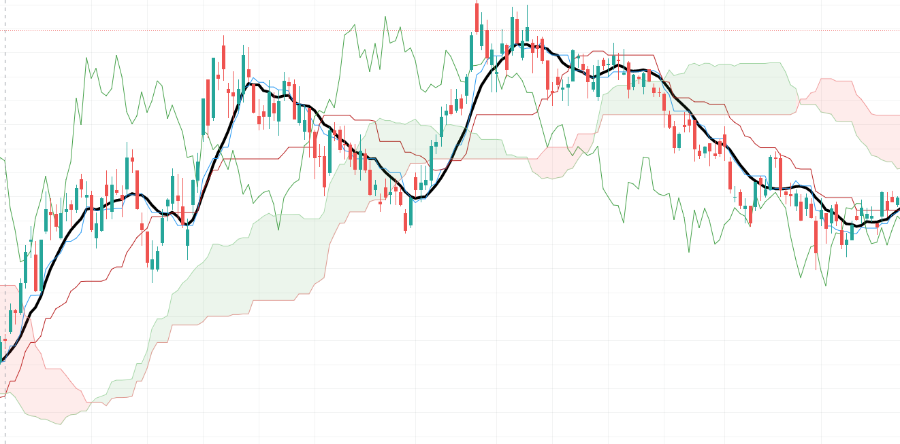
BackTesting - To test the subordinate principle

Slide 14
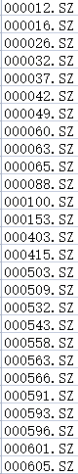
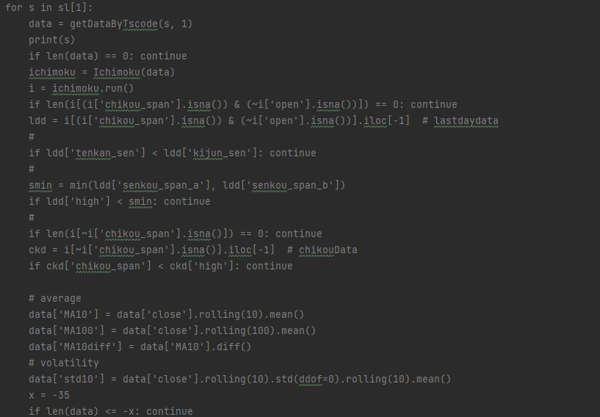
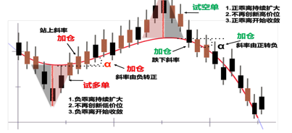
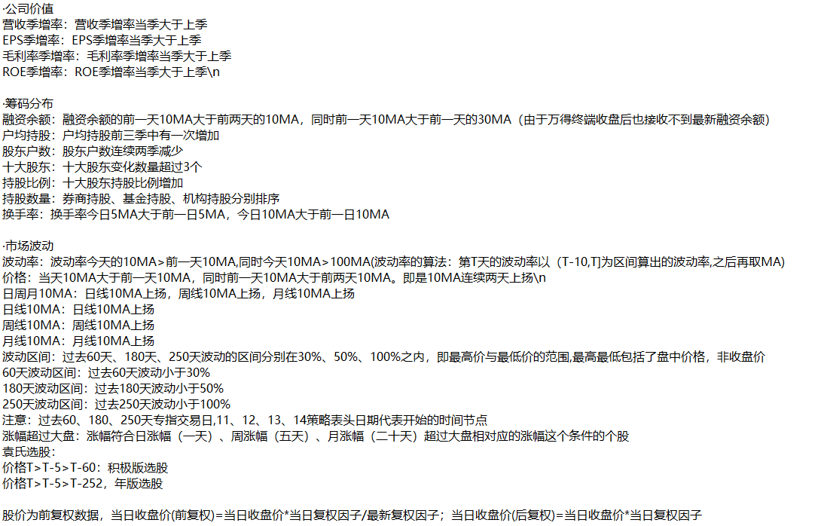
Strategy
Products waiting to be observed(Manually this time)
Basic principle
PLUS
Subordinate principle(The combination after backtesting)
Using pandas

Slide 15
03
Consequent

Slide 16
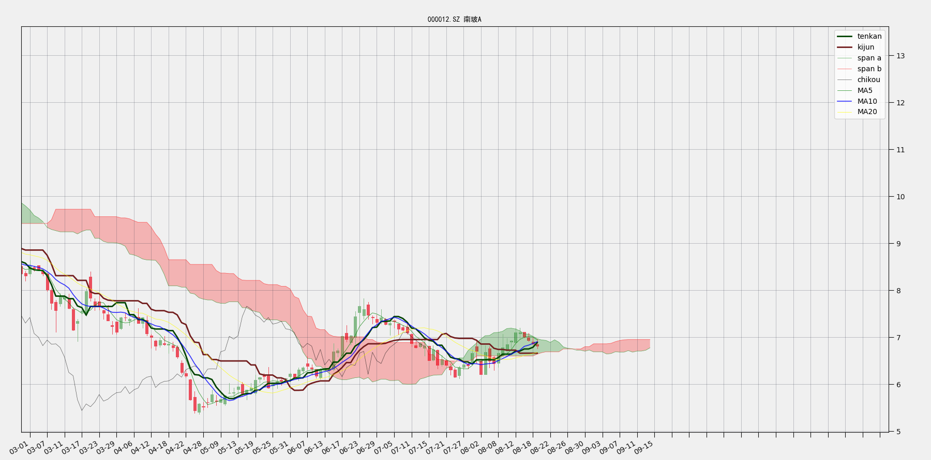
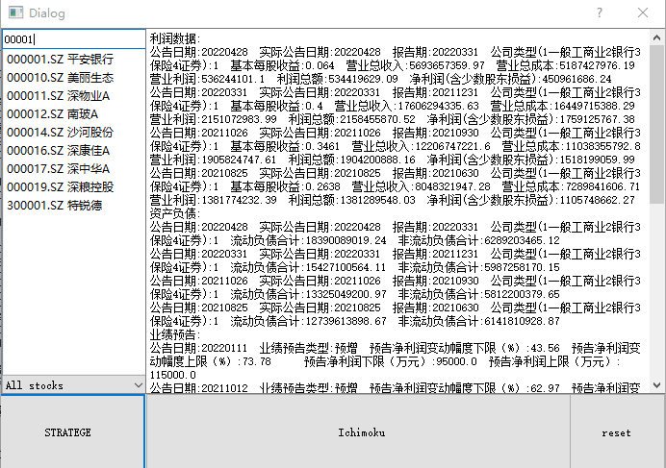
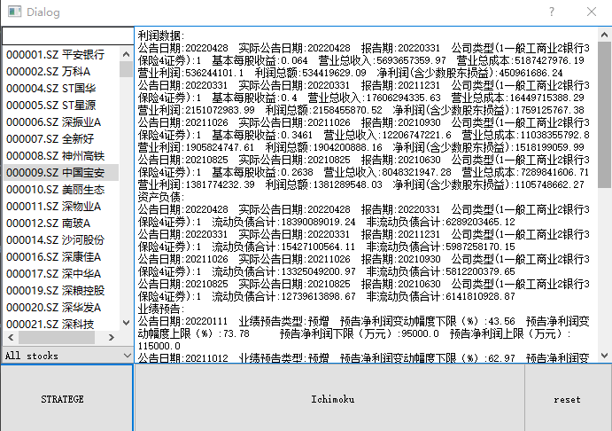
Consequent

Slide 17
THANK YOU FOR YOUR LISTENING
部门：稻壳团队
汇报人：Docer

